Slide 1
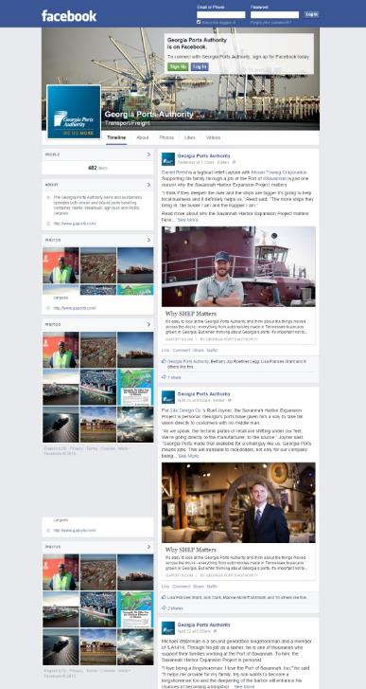
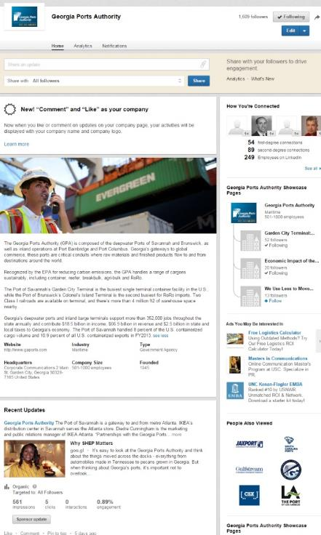
Georgia Ports Authority
Social Media Launch
Social/Web Based Media

